Slide 1
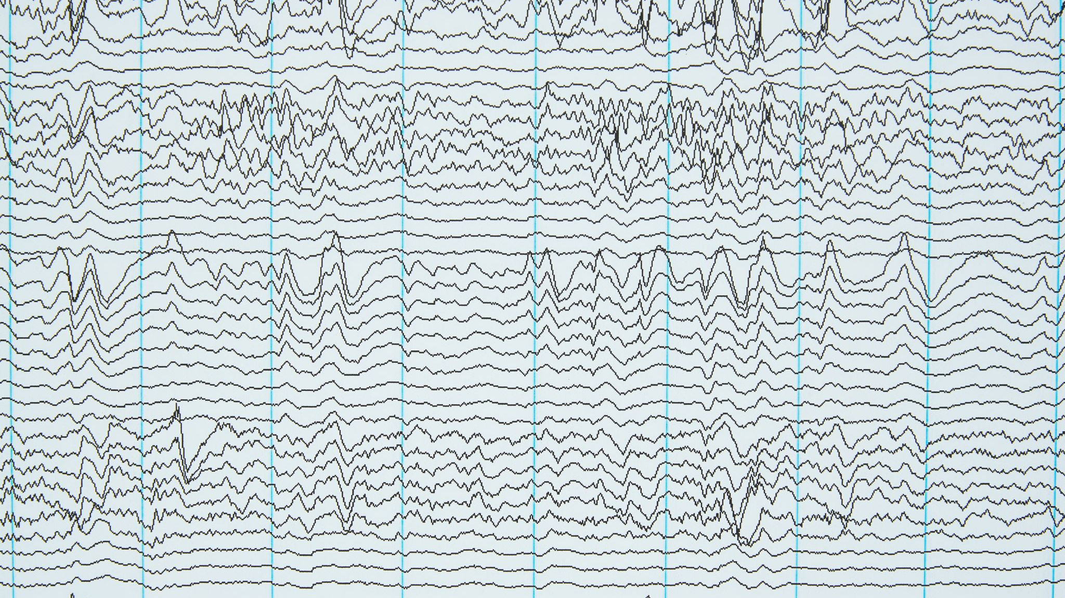
Earthquake Detector
Supervised by Dr/ Abeer Twakol

Slide 2

Introduction
Title of the presentation: "Earthquake Detector using MPU6050 Sensor"
Introduction
The importance of earthquake detection and monitoring

Slide 3
Objective
Earthquake detecting
the purpose of building an earthquake detector using the MPU6050 sensor
The benefits and applications of such a system

Slide 4
Overview of MPU6050 Sensor
introduction to the MPU6050 sensor
Features and capabilities
The working principle of the sensor

Slide 5
Earthquake Detection System Design
The overall design of the earthquake detection system
The components involved, including the MPU6050 sensor, microcontroller, and other necessary peripherals
A block diagram or schematic representation of the system

Slide 6
Working Principle
The working principle of the earthquake detection system
How the MPU6050 sensor measures vibrations and accelerations
The role of the microcontroller in processing the sensor data

Slide 7
Data Processing and Analysis
the data processing and analysis techniques used
algorithms or methods utilized to detect earthquake events
the importance of calibration and threshold setting

Slide 8

System Implementation
The practical implementation of the system
The hardware setup and connections

Slide 9
Results and Performance Evaluation
The results obtained from testing the system
The accuracy and reliability of the earthquake detection system
The performance against known earthquake events or standards

Slide 10
Applications and Future Scope
Potential applications of the earthquake detection system
01
Opportunities for further improvements or enhancements
02
The importance of real-time monitoring and early warning systems
03

